Slide 1
AI PM CAPSTONE • ATLIQ TECHNOLOGIES
Contract Risk
Analyzer
Stop Reviewing Every Word,
Start Making Decisions
An evidence-grounded AI copilot to surface risky clauses, retrieve prior commitments and help the reviewer make informed decisions.
Azaruddin Tamboli • AI Product Manager • PRD v1.0, draft
01

Slide 2
01 • EXECUTIVE SUMMARY
The opportunity: faster first-pass review, without outsourcing judgment
The user
The problem
The product
Karandeep, founder and CEO, reviews and signs contracts while managing the business.
Manual clause review plus fragmented context across contracts, emails, chats and negotiation notes.
A review workspace that extracts terms, finds potential risks, retrieves evidence and flags missing checks.
3–4
4–5
~2 hrs
6–8 hrs
Contracts / month
NDAs / month
Standard review
Complex review
Stakeholder-reported
Stakeholder-reported
Manual effort baseline
2–3 passes reported
Product promise: reduce review effort while preserving traceable evidence, explicit uncertainty and human final decisions.
Contract Risk Analyzer | AI PM Capstone
2

Slide 3
02 • PROBLEM EVIDENCE
The cost is not only reading the contract. It is finding the context.
7–9
2 hrs
6–8 hrs
1 wk–1 mo
Documents / month
Typical first review
Complex review
Queue turnaround
Contracts + NDAs
Reported baseline
Often 2–3 passes
Elapsed time, not effort
Today’s review is fragmented
The product hypothesis
• Read the incoming contract clause by clause
• Search past contracts for earlier promises and restrictions
• Find relevant emails, chats and negotiation notes
• Check annexures, parties and required agreements
• Consolidate findings before a decision
If AI assembles the relevant evidence and flags potential issues in one workspace, the reviewer can spend less time searching and more time exercising judgment.
Contract Risk Analyzer | AI PM Capstone
3

Slide 4
03 • DISCOVERY INSIGHTS
Discovery: the reviewer needs context, not a generic red-flag checklist
Insight 1 • Fragmented memory
Insight 2 • No universal checklist
Karandeep
Relevant commitments may sit in older contracts, emails, chats and negotiation notes.
The reviewer wants a balanced, win-win contract, not every non-standard clause flagged as bad.
Founder & CEO
Primary contract reviewer
Goal
Make informed decisions quickly without overlooking material risks or prior commitments.
Insight 3 • Context changes risk
Insight 4 • Completeness matters
A new contract may conflict with a prior industry or geographic restriction.
For applicable healthcare work, verify required BAAs and relevant parties, including freelancers where required.
Human signs every contract
Contract Risk Analyzer | AI PM Capstone
4

Slide 5
04 • ROOT-CAUSE ANALYSIS
Five whys: the bottleneck is manual context assembly
1
Review takes too long
The reviewer reads, searches and reconciles manually.
2
Relevant evidence is scattered
Prior terms live across different files and conversations.
3
There is no single review workspace
Terms, risks, historical context and missing docs are not assembled together.
4
Generic checklists miss business context
Risk depends on approved policy and prior commitments, not just clause labels.
5
The process depends on human memory
No system links a proposed term to the relevant historical evidence.
Root cause → evidence and context are not assembled into one traceable review flow.
Contract Risk Analyzer | AI PM Capstone
5

Slide 6
05 • OPPORTUNITY CHOICE
Choose the workflow where AI adds leverage and humans keep control
Prioritise for value, feasibility and cost of error
Build first
Build first
Build first
Contract extraction + evidence-grounded clause findings
Historical commitment retrieval and conflict flags
Completeness checks + consolidated review workspace
Defer until validated
• Autonomous approve, reject or sign
• Automatic negotiation or redlining
• Universal legal risk scoring without an approved policy
• Live integrations before data access and security are approved
Decision rule
Use deterministic rules for predictable checks; use retrieval and LLMs where interpretation and summarisation are needed. Always show evidence.
Contract Risk Analyzer | AI PM Capstone
6

Slide 7
06 • SOLUTION
One review workspace, four core capabilities
F1
Understand
F2
Find risks
Extract parties, value, scope, dates, obligations, termination and key terms.
Flag potentially risky clauses with category, severity, explanation and source location.
F3
Recall commitments
F4
Verify & decide
Retrieve relevant signed contracts, emails and notes; compare prior restrictions with the proposed deal.
Check configured requirements, show uncertainty, let reviewer confirm/dismiss/flag and record decisions.
Operating principle: the system proposes findings; the authorised human owns the decision.
Contract Risk Analyzer | AI PM Capstone
7

Slide 8
07 • END-TO-END WORKFLOW
From upload to a decision with evidence at every step
1
2
3
4
5
6
7
Upload
Extract
Retrieve
Analyse
Validate
Report
Review
Validate file
Terms + locations
Historical sources
Risks + conflicts
Completeness + rules
Evidence + uncertainty
Human decision
If evidence is missing or weak
If revision is needed
Mark the check incomplete or uncertain. Never present it as passed.
Upload the revised contract and re-review the full document, not only changed clauses.
Contract Risk Analyzer | AI PM Capstone
8

Slide 9
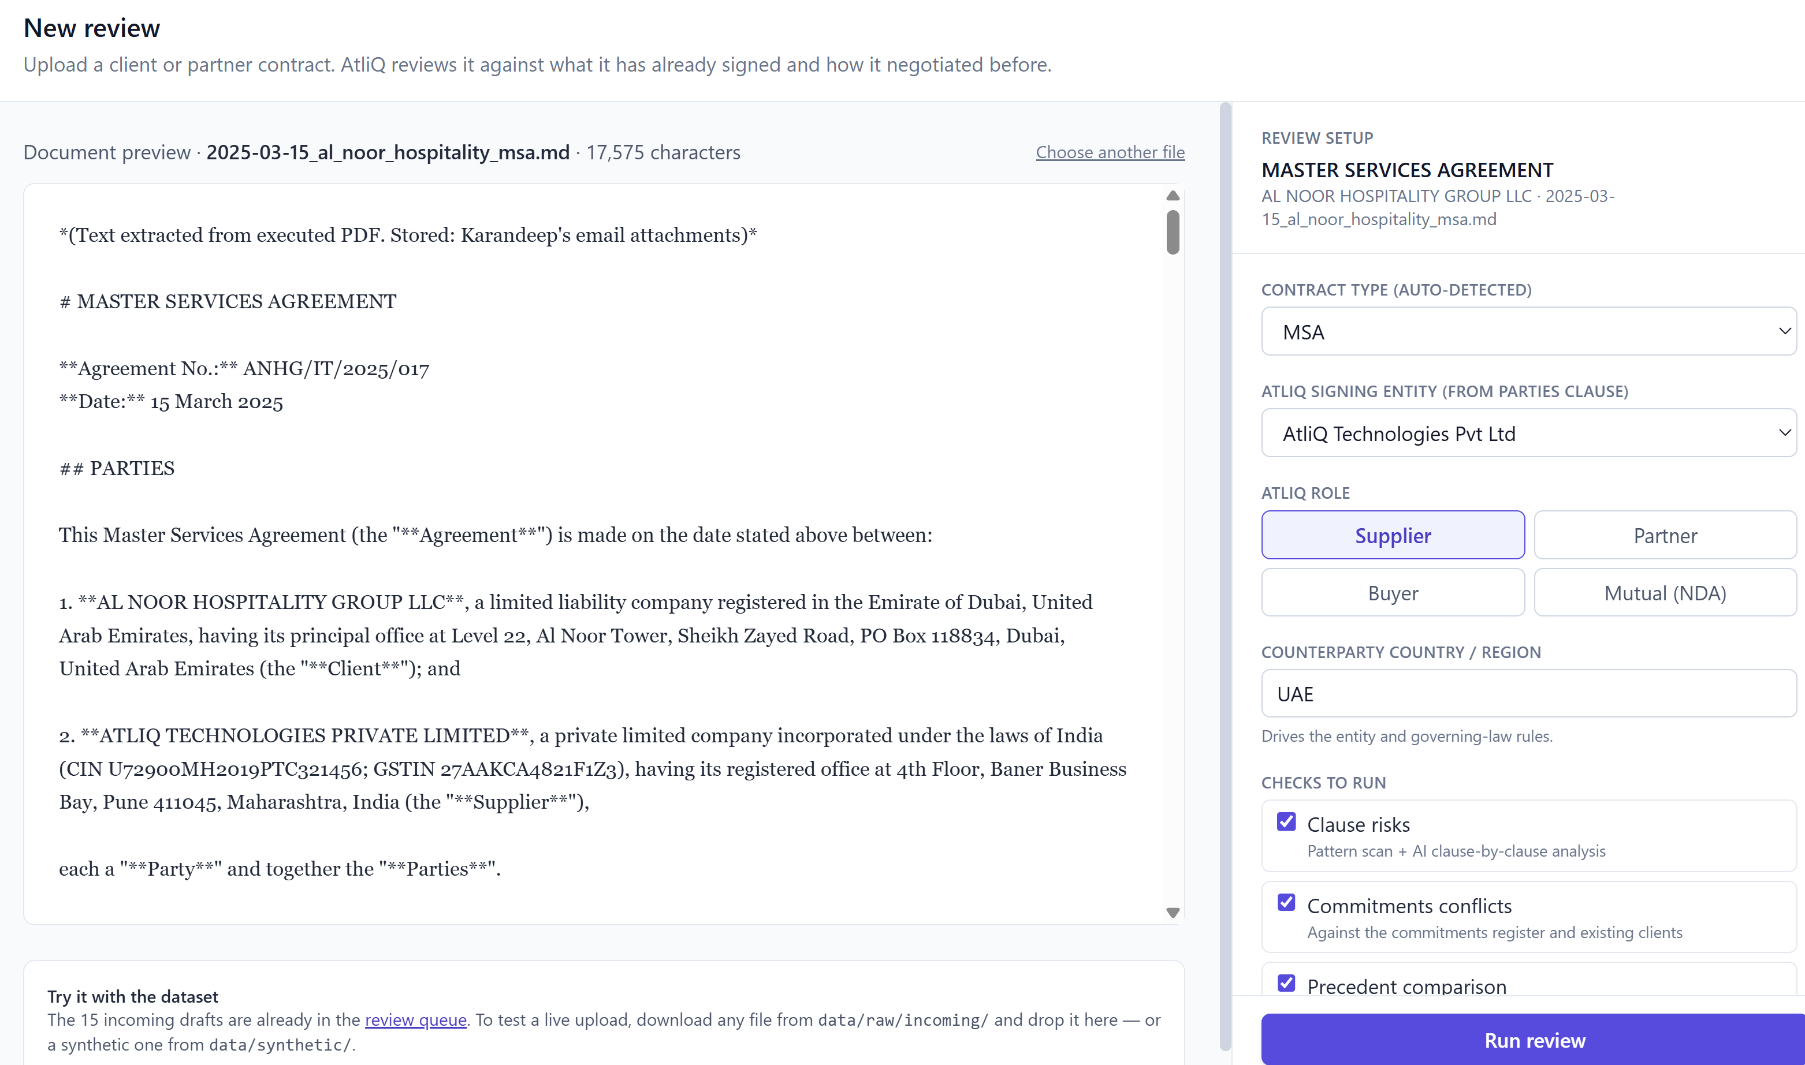
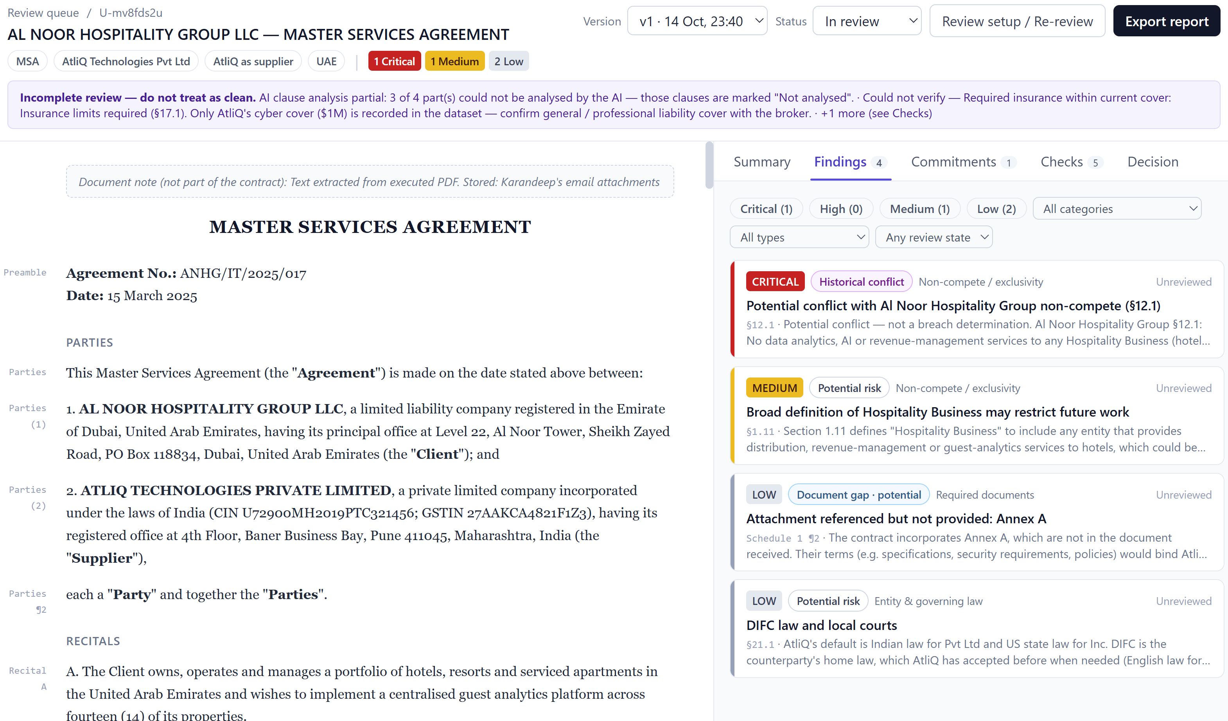
08 • PRODUCT WALKTHROUGH
Walkthrough: review the clause and its evidence side by side
CONTRACT REVIEW / SAMPLE CLIENT AGREEMENT
DEMO DATA
Contract Risk Analyzer | AI PM Capstone
9

Slide 10
09 • AI AND SYSTEM DESIGN
Rules where possible, retrieval and LLMs where needed
Input documents
Parse & extract
Retrieve context
Analyse
Validate
PDF / DOCX
Text + page refs
Authorised sources
LLM + rule checks
Evidence gates
Use code / rules for
Use retrieval + LLM for
• Required-field checks and configurable rules
• Status, permissions, audit events
• Clause interpretation and summaries
• Finding relevant prior commitments
Contract Risk Analyzer | AI PM Capstone
10

Slide 11
10 • SUCCESS METRICS
Measure time saved only if risk-detection quality holds
−50%
< 5 min
100%
≥ 80%
Median human review effort
First-pass report
Configured checks statused
Reviewer acceptance
Proposed North Star target
AI processing target
Complete / flagged / incomplete
Proposed pilot target
Quality gates before launch
• Evidence accuracy: ≥95% of evaluated findings traceable
• Risk category/severity agreement: ≥85%
• Historical conflict recall: ≥90%
• False positives: ≤20% on labelled evaluation set
• Uncertainty/incomplete-case handling: ≥95%
Measure two clocks separately
Human effort: standard review ~2 hours; complex review ~6–8 hours. Queue turnaround: reported as 1 week to 1 month. Establish a measured pilot baseline before claiming improvement.
Contract Risk Analyzer | AI PM Capstone
11

Slide 12
11 • EVALUATION PLAN
A demo is not proof: evaluate against labelled cases
Extraction
Parties, dates, value, obligations
Field-level accuracy against labelled examples
Risk findings
Known risky and acceptable clauses
Recall, precision / false positives, severity agreement
Historical conflicts
Prior restrictions vs proposed terms
Conflict recall; source status and relevance
Evidence grounding
Quoted clause and historical source
Citation correctness; unsupported finding rate
Completeness
Missing annexure, BAA or relevant party
Correctly flagged incomplete/uncertain cases
Reliability
Unreadable files, extraction/retrieval failures
Visible failure states; no silent clean report
Contract Risk Analyzer | AI PM Capstone
12

Slide 13
12 • RISK & RESPONSIBLE AI
Highest risks, and the guardrail for each
Hallucinated clause or commitment
Require traceable source spans; withhold unsupported findings.
Historical conflict treated as a breach
Label as potential conflict; show both sources and agreement status.
Draft / superseded agreement used as active
Track source type, status and date; distinguish signed, draft and superseded.
Missing evidence shown as passed
Every configured check must be completed, flagged or incomplete.
Sensitive contract data exposed
Use authorised sample data for prototype; validate access, retention and provider terms before real data.
AI makes final legal decision
No autonomous approval, rejection or signing; human decision and audit trail required.
Kill switch: any data leak, unsupported material claim or critical known-risk miss pauses the pilot.
Contract Risk Analyzer | AI PM Capstone
13

Slide 14
13 • ROLLOUT PLAN
Earn trust in stages; do not jump from prototype to production
Phase 1
Phase 2
Phase 3
Phase 4
Synthetic-data prototype
Offline evaluation
Shadow pilot
Controlled rollout
Build UI, upload flow, extraction and report. No real contracts.
Test labelled risks, historical conflicts, missing evidence and failure cases.
Authorised reviewers compare AI report with manual review; no decisions automated.
Approved access, audit logging, monitoring and feedback loop.
Gate: workflow works end-to-end.
Gate: quality thresholds met.
Gate: quality and usefulness validated.
Gate: security/privacy approval + zero guardrail breaches.
Production integrations, live repositories and external AI-provider use remain out of scope until approved.
Contract Risk Analyzer | AI PM Capstone
14

Slide 15
14 • FEASIBILITY & OPEN QUESTIONS
Cost and assumptions: validate before promising ROI
Known inputs
Cost model
ROI discipline
7–9 docs/month; standard review ~2h; complex review ~6–8h; queue turnaround ~1 week to 1 month.
Estimate inference, embeddings/indexing, hosting/storage, security and human verification separately.
Calculate time saved only after pilot. Do not convert reported $5,000 spend into savings until its meaning is confirmed.
Contract Risk Analyzer | AI PM Capstone
15

Slide 16
15 • RECOMMENDATION
Make the first review faster.
Make every finding verifiable.
The MVP succeeds when it reduces manual search effort without hiding uncertainty or weakening human judgment.
1
Build a working end-to-end prototype
2
Evaluate against labelled, representative cases
3
Run a shadow pilot before live use
Contract Risk Analyzer • AtliQ Technologies • Draft for AI PM capstone
16

